Slide 1
Chapter 4
Generating Permutations and Combinations

Slide 2
Summary
Generating permutations
Inversions in Permutations
Generating combinations
Generating r-combinations

Slide 3
Mobile Integer
Given an integer k we assign a direction to it by writing an arrow above it pointing to the left or to the right. Consider a permutation of {1,2,…,n} in which each of the integers is given a direction.
The integer k is called mobile if its arrow points to a smaller integer adjacent to it.

Slide 4
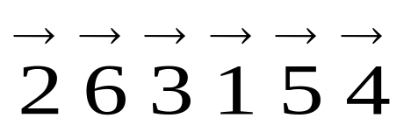
Example for mobile integer
For only 3, 5, and 6 are mobile.
Integer 1 can never be mobile since there is no integer smaller than 1.
The integer n is mobile, except in two cases:
  n is the first integer and its arrow points to the left.
  n is the last integer and its arrow points to the right.

Slide 5
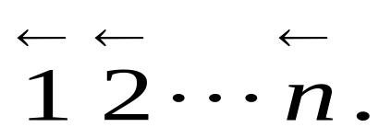
Algorithm for Generating the Permutations of {1,2,…,n}
Begin with
While there exists a mobile integer, do
find the largest mobile integer m.
switch m and the adjacent integer its arrow points to.
switch the direction of all integers p with p>m.

Slide 6
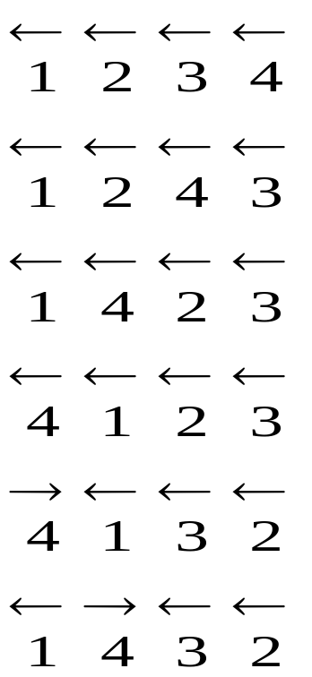
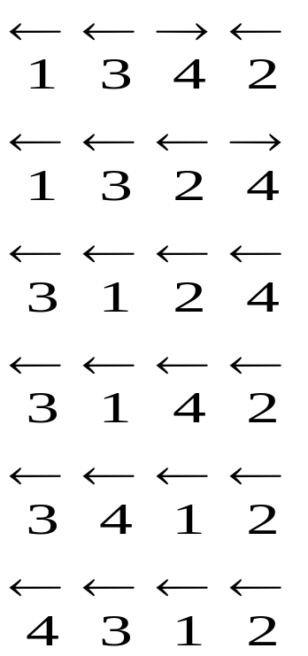
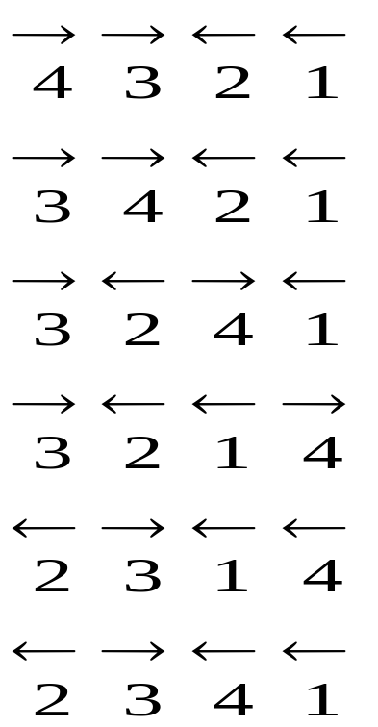
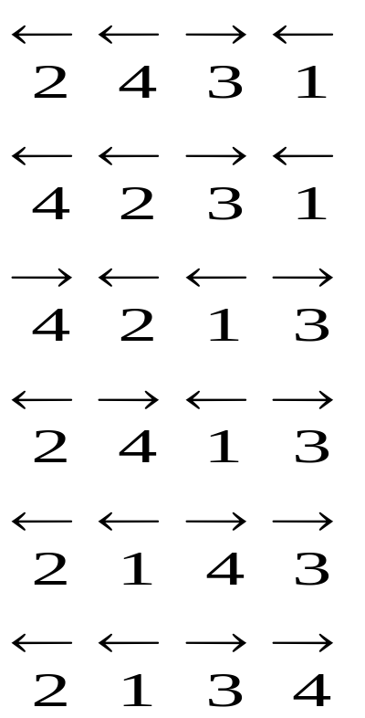
Illustration of the Algorithm

Slide 7
Exercises
For n =3, illustrate the above algorithm
For n =4, illustrate the above algorithm

Slide 8
Inversions in Permutations
Let i₁i₂.... i_{n} be a permutation of the set {1,2, …,n}. The pair (i_{k}, i_{l}) is called an inversion if k<l and i_{k}>i_{l}.
An inversion in a permutation corresponds to a pair of numbers which are out of their natural order.
The only permutation of {1,2, …,n} with no inversions is 1 2 … n.

Slide 9
The number of inversions
Let a_{j} denote the number of inversions. It equals the number of integers which precede j in the permutation but are greater than j; it measures how much j is out of order.
The sequence of numbers a₁, a₂, …, a_{n} is called the inversion sequence of the permutation i₁i₂.... i_{n} .
The number a₁+ a₂+ …+ a_{n} measures the disorder of a permutation.

Slide 10
Examples of inversions
Consider the permutation 31524. It has four inversions, namely (3, 1), (3, 2), (5, 2), (5, 4).
The inversion sequence of the permutation 31524 is 1, 2, 0, 1, 0.
Q: The inversion sequence of the permutation 32514 is ???

Slide 11
A theorem
Let b₁, b₂, …, b_{n} be a sequence of integers satisfying
Then there exists a unique permutation of {1, 2, …, n} whose inversion sequence is b₁, b₂, …, b_{n} .

Slide 12
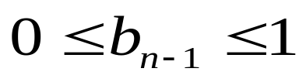
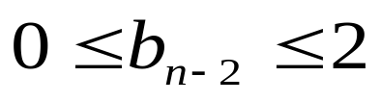
Algorithm I
n: write down n.
n-1: consider b_{n-1}. We are given that
If b_{n-1} =0, then n-1 must be placed before n. If b_{n-1} =1, then n-1 must be placed after n.
n-2: consider b_{n-2}. We are given that
If b_{n-2} = 0, then n-2 must be placed before the two numbers from step n-1. If b_{n-2} =1, then n-2 must be placed between the two numbers from step n-1. If b_{n-2} =2, then n-2 must be placed after the two numbers from step n-1.

Slide 13
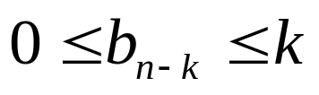
Algorithm I (cont’d)
n-k: (general step) consider b_{n-k}. We are given that In step n-k+1, the k numbers n, n-1, …, n-k+1 have already been placed in the required order. If b_{n-k} = 0, then n-k must be placed before all the numbers from step n-k+1. If b_{n-k} =1, then n-k must be placed between the first two numbers ……. If b_{n-k} =k, then n-k must be placed after all the numbers from step n-k+1.
1: We must place 1 after the b_{1st} number in the sequence constructed in step n-1.

Slide 14
Comments on Algorithm I
The algorithm can determine the unique permutation of {1, 2, …, n} whose inversion sequence is b₁, b₂, …, b_{n} .
The disadvantage of this algorithm is that the location of each integer in the permutation is not known until the very end; only the relative positions of the integers remain fixed throughout the algorithm.

Slide 15
Algorithm II
Begin with n empty locations which label 1, 2, …, n from left to right
1: put 1 in location number b₁ +1
2: put 2 in the (b₂ + 1)st empty location
……
k: (general step) counting from the left we put k in the (b_{k} +1)st empty location.
n: put n in the one remaining empty location.

Slide 16
Comments on Algorithm II
The algorithm can determine the unique permutation of {1, 2, …, n} whose inversion sequence is b₁, b₂, …, b_{n} .
The advantage of this algorithm is that the location of each integer in the permutation can be determined.

Slide 17
Example
Determine the permutation of {1, 2, 3, 4, 5, 6 ,7 ,8} whose inversion sequence is 5, 3, 4 ,0, 2, 1, 1, 0.
8
87
867
8657
48657
486537
4862537
48625137
 |  |  |  |  | 1
 |  |  | 2 |  | 1
 |  |  | 2 |  | 1 | 3
4 |  |  | 2 |  | 1 | 3
4 |  |  | 2 | 5 | 1 | 3
4 |  | 6 | 2 | 5 | 1 | 3
4 |  | 6 | 2 | 5 | 1 | 3 | 7
4 | 8 | 6 | 2 | 5 | 1 | 3 | 7

Slide 18
Exercises
Determine the permutation of {1, 2, 3, 4, 5, 6 ,7 ,8} whose inversion sequence is 7, 3, 4 ,4, 2, 1, 1, 0.
Algorithm I: insert the integers one by one
Algorithm II: find the locations of the integers one by one.

Slide 19
An example
Bring the permutation 361245 to 123456 by successive switches of adjacent numbers.
The inversion sequence is 220110. Hence there will be 6 times of switch.
3 | 6 | 1 | 2 | 4 | 5
3 | 1 | 6 | 2 | 4 | 5
1 | 3 | 6 | 2 | 4 | 5
1 | 3 | 2 | 6 | 4 | 5
1 | 2 | 3 | 6 | 4 | 5
1 | 2 | 3 | 4 | 6 | 5
1 | 2 | 3 | 4 | 5 | 6

Slide 20
Generating combinations
Let S = {x_{n-1}, …, x₁, x₀} be a set of n elements. We now seek an algorithm which generates all of the 2^{n} combinations (subsets) of S.
We identify the 2^{n} combinations with the 2^{n} n-tuples (a_{n-1}, …, a₁, a₀) = a_{n-1}…a₁a₀ of 0’s and 1’s, where the ith term a_{i} correspond to the element x_{i} for each i = 0, 1, …, n-1.

Slide 21
Base 2 algorithm for generating the combinations of {x_{n-1}, …, x₁, x₀}
Begin with a_{n-1}…a₁a₀ = 0…00.
while a_{n-1}…a₁a₀ ≠ 1…11, do:
1) find the smallest integer j (between n-1 and 0) such that a_{j} = 0.
2) replace a_{j} by 1 and each of a_{j-1}, …, a₀ (which by our choice of j all equal 1) by 0.

Slide 22
Example
List the 16 combinations of the set S = {1, 2, 3, 4}

Slide 23
Generating r-combinations
Let A and B be two r-combinations of the set {1, 2, …, n}. Then, we say that A precedes B in the lexicographic order provided the smallest integer which is in their union A∪B but not in their intersection A ∩ B is in A.

Slide 24
Example and Exercise
Let 5-combinations A and B of {1, 2 ,…,8} be given by A = {2,3,4,7,8}, B= {2, 3 ,5 ,6 ,7}. Then the smallest element which is in one but not both of the sets is 4. Hence A precedes B in the lexicographic order.
Consider 5-combinations of {1,2,…,9}. What 5-combination immediately follows 12389?

Slide 25
A theorem
Let a₁a₂…a_{r} ≠ (n-r+1)(n-r+2)…n be an r-combination of {1, 2, …, n}. Let k be the largest integer such that a_{k}< n and a_{k}+1 is different from each of a₁, a₂, …a_{r}.Then the r-combination which is the immediate successor of a₁a₂…a_{r} in the lexicographic ordering is
a₁…a_{k-1}(a_{k}+1)(a_{k}+2)…(a_{k}+r-k+1).

Slide 26
An example
Consider the 5-combination a₁a₂a₃a₄a₅ = 12389 of {1, 2, …, 9}. For k =3, a_{k} = 3 < 9 and a_{k}+1 = 4 is different from 1, 2, 3, 8, 9. Then the r-combination which is the immediate successor of a₁a₂…a₅ in the lexicographic ordering is a₁a₂(a₃+1)(a₃+2)…(a₃+5-3+1) = 12456.

Slide 27
Algorithm for generating the r-combinations
Begin with the r-combination a₁a₂…a_{r} =12…r. While a₁a₂…a_{r} ≠ (n-r+1)(n-r+2)…n, do
1) determine the largest integer k such that a_{k}+1 ≤ n and a_{k}+1 is not one of a₁, a₂, …a_{r .}
2) replace a₁a₂…a_{r} with the r-combination a₁a₂…a_{k-1}(a_{k}+1)(a_{k}+2)…(a_{k}+r-k+1).

Slide 28
Example for illustrating the algorithm
Generate the 4-combinations of S = {1,2,3,4,5,6}.
1234; 1235; 1236;
1245;1246; 1256;
1345; 1346; 1356;
1456; 2345; 2346;
2356; 2456; 3456.

Slide 29
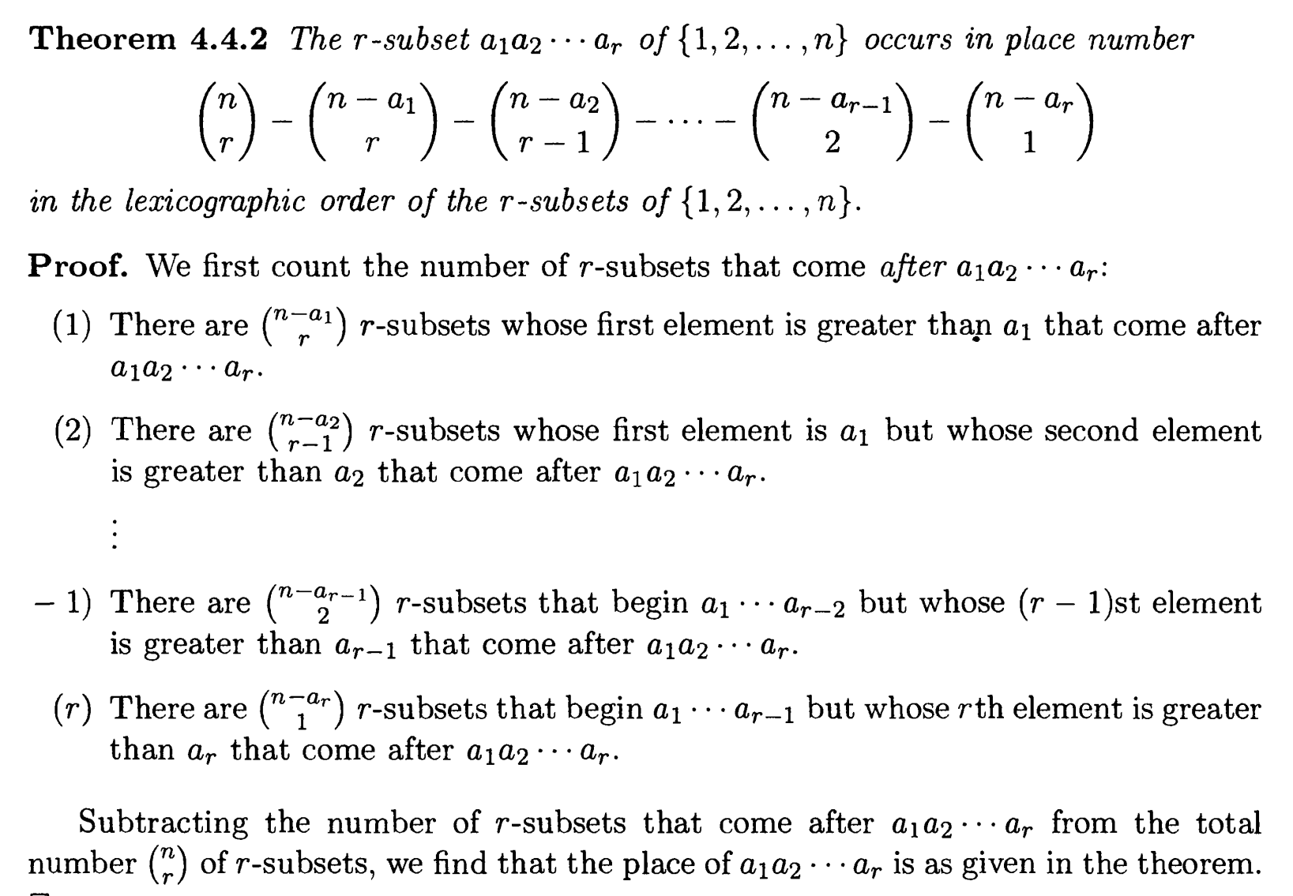

Slide 30
Exercises
In the previous example
What is the immediate predecessor of 1346?
What is the position of 1346 in the lexicographic ordering?
What is the last 4-combination in the lexicographic ordering with digit 2 ? The position is ?

Slide 31
Example for illustrating the algorithm
Generate the 4-combinations of S = {1,2,3,4,5,6}.
1234; 1235; 1236;
1245;1246; 1256;
1345; 1346; 1356;
1456; 2345; 2346;
2356; 2456; 3456.
e.g., the position of 1356 is calculated as follows:
From 12AB to 13CD, there are C(4,2) combinations, i.e., for 12AB, there are C(4,2) choices for AB. Then, for 13CD, there are C(3, 2) choices for CD and 1356 is the last one with the form 13CD. C(4,2)+C(3,2) = 9

Slide 32
Comments
Now we understand how to generate permutations and r-combinations of a set.
Question: How to generate r-permutations of an n-element set?
If we combine the algorithm for generating permutations of a set with the algorithm for generating r-combinations of an n-element set, we obtain an algorithm for generating r-permutations of an n-element set.

Slide 33
Exercise
Generate the 3-permutations of {1,2,3,4}.

Slide 34
Assignments
6(a)
7(a)
15(b)
29
33.

